Slide 1
456 West Main Street Norwich, CT 06360 800-888-5275 theresa@tzellyouthexchange.com

Slide 2
ABOUT OUR AGENCY AND THE ROTARY DEPARTMENT
Over 65 years in the travel industry
Full-service agency offering leisure, corporate, group and meeting travel services
Over 30 years arranging Rotary Youth Exchange travel and documentation
Three full-time agents dedicated to Rotary Students and their parents
Notes:
Tzell Youth Exchange has been in the travel industry for over 65 years. We are a located in Norwich, CT and are a full service travel agency that offers assistance with leisure, corporate and group and meeting travel services. We have been assisting Rotary students and their parents for over 30 years with travel and visa documentations. We have 3 full time agents who are fully dedicated to Rotary Students and their parents.

Slide 3
SERVICES PROVIDED TO ROTARY STUDENTS
Step-by-step, easy to follow instructions for completing visa or residency permit documents
Air tickets that meet Rotary requirements
Toll free number for students and parents to receive advice and ask questions
Extended hours of operation during the summer months
Notes:
During the course of this presentation I will go over information that will pertain to you as students. If you have any questions throughout the presentation please jot them down as we will have a question and answer session at the end.
Some of the services that we provide at Tzell Youth exchange are step by step, easy to follow instructions for completing visa or residency permit documentation. We also issue tickets that will only meet Rotary Requirements and we offer a toll free number for students and parents to use to ask questions and receive advise for the exchange process.
We also off extended hours of operations during the summer months which means that an agent will be available to take phone calls and answer questions from Monday to Thursday from 8:30am to 7:00pm and Saturdays from 9:00am to 1:00pm, EST.

Slide 4
HOW TO REGISTER
Go to our website:
www.tzellyouthexchange.com
Click on the link for “Registration”
Complete all required information
Notes:
Your first order of business is to register with us. To do this you must go to www.tzellyouthexchange.com. Click on the tab for registration and complete all required info.

Slide 5
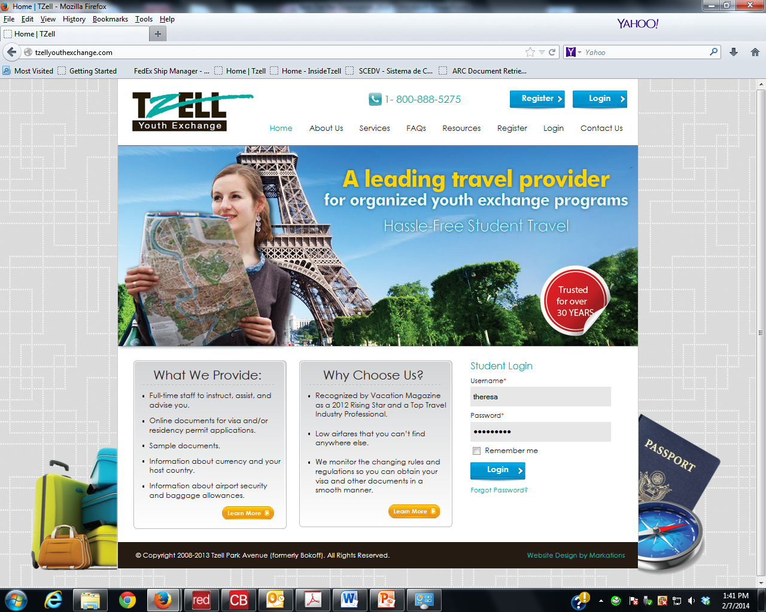
Notes:
Here you will find all information pertaining to our services as well as a frequently asked questions page and a contacts page that can provide contact info for airlines and insurance. At the top of this page you will find the button to register.

Slide 6
REGISTRATION DEADLINES
BEFORE APRIL 1ST: $125.00
APRIL 2ND UNTIL JULY 1ST: $175.00
AFTER JULY 1ST: $225.00

Slide 7
WHAT IS A VISA?
A visa is official permission from a foreign government to enter that country and stay for a specified period of time
Notes:
For most of you a visa is needed in order to travel to your host country. A visa is the official permission from a foreign government to enter that country and stay there for a specific amount of time.

Slide 8
Requirements vary country by country and consulate by consulate
Consulates have the ability to change visa requirements and fees at any time
Send us documents as you complete them
Notes:
Visa Requirements will vary from country to country as well as consulate to consulate. Your friend for instance that is going to France will be required to complete completely different documents that you will need to complete to Thailand. So we ask that you do not compare requirements with other students as this will only confuse you.
Keep in mind that Consulate have the ultimate say on what is required to obtain a visa and they have the ability to change visa requirements, requesting additional documents or change and increase fees at any time.
We ask that you be sure to send your documents to us as you complete them. This will allow us time to look them over and advise you of any corrections that may need to be made.

Slide 9
PERSONAL APPEARANCE VS. APPLICATIONS ACCEPTED BY MAIL
PERSONAL APPEARANCE
APPLICATIONS BY MAIL
Student sends photocopies of ALL documents by fax or email
Once agent reviews, student is sent info for setting appointment/going to Consulate
Under 18 must be accompanied by adult
May be requested any time
Student sends ORIGINALS of ALL documents, including passport by courier
Once agent reviews, documents are sent to the appropriate Consulate
Agent will notify student of any problems or when visa is approved and received back
Notes:
There are two different ways of obtaining a visa in the US. The first way would be by a personal appearance, which means that the consulate or embassy requries that you apply in person at the appropriate consulate or embassy. You should send copies of your completed documents as you complete them. Once your agent reviews all of your completed document and sees that they are complete then you will be provided with the contact information, and instructions on setting your appointment with the consulate if necessary or simply instructions on your personal appearance. If you are under of the age of 18, in most cases, you must be accompanied by at least 1 adult for your personal appearance. Also, even if a personal appearance is not required it may be requested at any time. The 2nd type a visa application would be applied for by mail. Students are to send all original documents to their agent at Tzell. Once we have received all of the requirements and see that it is complete then documents will be sent to the appropriate consulate for visa approval. Once the visa has been approved or if any additional documents are requested by the consulate then your agent will contact you immediately.

Slide 10
RECEIVING DOCUMENTS ONLINE
Students will create a username and password when registering.
CHECK YOUR ACCOUNT OFTEN FOR UPDATES
Notes:
These documents that I am referring to will be provided through your online account, which you will receive access to once you register with us. When you register you will create a username and password to create your personal account on our website. Be sure to check your account often as documents will be posted there once we have updated them. You will also receive an email from your agent once the required documents have been posted.

Slide 11
COMPLETING DOCUMENTS
Read through everything before beginning to fill out any papers
Use your full name as it appears on your passport
Pay close attention to samples
Notes:
Once you have received your required documents you should be sure to read through everything prior to filling anything out. This will help you understand what documents will be required of you. Be sure that when you are filling out these forms that you enter your name as it appears in your passport. Please do not use nicknames or initials, again, unless it is as it appears in your passport. Finally, please be sure that you pay close attention to the samples that we provide. Keep in mind that these are only meant to be used as a guide to assist you in completing your required forms. We complete these forms as if we are the student so please be sure to use them as samples only.

Slide 12
DOCUMENTS
Some documents will require notarization; if you do not know a notary public look for one in the yellow pages (www.yellowpages.com)
If biological parents do not reside together, two separate forms may be completed and notarized separately
Many (but not all) Consulates require submission of the applicants birth certificate WITH A RAISED SEAL. If you only have one original birth certificate it is a good idea to get another certified copy now (www.vitalchek.com)
Notes:
Some of the documents that you will be required to complete will require a notarization. If you do not know of any notary publics you can look for one in the yellow pages or online. If your biological parents or legal guardians do not reside together than two separate forms may be completed and notarized separately. Many but not all consulates require an original birth certificate to be submitted. If you have only birth certificate you may want to look into getting a second original birth certificate. You can do this by going to your town or city hall or going to www.vitalcheck.com.

Slide 13
Sign all documents in blue ink
Print out a copy of all documents you complete to keep at home
Use your document checklist
Notes:
We ask that you please be sure to sign all required documents in blue ink. Especially important are the visa or residency permit application forms. This will allow the consulate to see that the signatures on the forms are authentic. Make sure that you print all documents and keep a copy of the completed documents at home with you for your reference. Also, we provide a document check off list, be sure that you use this. This will let you know what documents have already been submitted and what documents still need to be completed and sent to your agent at Tzell Youth Exchange.

Slide 14
ADHERE TO DEADLINES!
Notes:
Make sure that you adhere to all deadline dates provided to you. We set these deadline dates in accordance to past experience with Consulates and Embassies. Making sure that your documents are submitted by these dates will give us enough time to look them over and have you make any corrections if needed.

Slide 15
PASSPORT
ALL students will need a valid passport in order to travel
Must be valid for at least 6 months from your expected date of return
Sign full name in blue or black ink only
Notes:
All students will be required to have a valid passport to travel any host country. For most countries the validity of the passport must be at least 6 months beyond your expected date of return. Which means that for most of you the expiration date of your passport should be no earlier than February of 2016. Be sure that you check the expiration date right away in case you must have it renewed. Also, you should be sure to sign your passport with your full name in blue or black ink only.

Slide 16
PASSPORTS
Parents should have a valid passport in case an emergency arises
Always send passports through traceable mail
Notes:
Parents should also have valid passports in case of any emergencies that may arise and require you to travel abroad. Also, many more consulates are starting to require that if the applicant is under the age of 18 than both parents must provide copies of their valid passports in order for the student to apply for their visa. Please be sure that when you are sending any passports to us that you send it by traceable mail only.

Slide 17
VISA APPLICATION PHOTOS
Notes:
The types of photos that are acceptable for your visa application is shown here. Typically about 2 by 2 inches. Each country has different requirements for their photos so please be sure to pay close attention to those requirements when you receive them. Consulates are very picky when it comes to the photos that are submitted so if they are not exactly who they are requested the consulate or Embassy has the ability to deny the visa solely on the photo submitted.

Slide 18
APPLICATION PHOTOS (PASSPORT SIZE &QUALITY)
Do NOT submit your own digital photos
Do NOT submit class photos, family photos, snapshots or other “personal” photographs
Save yourself (and us) time and go to a local drugstore, WalMart, or other retail location that takes PROFESSIONAL PASSPORT PHOTOS
Notes:
Do not, under any circumstance, submit your own digital photos. Please do not submit class photos or family photos. You will save yourself a lot of time if you contact a professional passport processor. This can be at your local Walmart, walgreens or AAA, basically anyone that develops or takes passport photos.

Slide 19
ACCEPTABLE PHOTOS
NON- ACCEPTABLE PHOTOS
Notes:
On the left are photos that are acceptable and on the right are photos that are not acceptable. Also, when you do purchase your photos and if they are not cut out for you already please be sure to cut your photos before sending. This will save us a lot of time.

Slide 20
ROTARY GUARANTEE FORM
Your official acceptance from your host country
This is NOT your visa application form
Sent from the host country to Rotary in the US
Do NOT wait for this form to arrive before sending us your other documents
Notes:
The Rotary Guarantee form is your official rotary acceptance from your host country. This is not the visa application form even though it does say on the top of the form Rotary Guarantee/Visa application form. Your visa application form, if required will be provided in your required documents. This documents is signed by you and your family, sponsoring club and then sent to your host country to be completed by the Host Club counselor, host club president, Host school and first host family. Since there are so many desks for this document to pass over it is often unknown when it will arrive back in the US. Unfortunately, there is no way to speed the process because it does have so many people to go through. Please do not wait for this document to arrive before working on your other requirements. This can often times arrive at the very last minute and is not required to complete all of the other forms.

Slide 21
AIRLINE TICKETS
Round trip
Valid for one year
Returns will changeable; at either no fee or a nominal fee charged by the airline.
Notes:
Once you have completed the visa process or have completed all the documents required to travel to your host country then we will start working on your air arrangements.
The types of airline tickets that we will issue through our office will always be roundtrip and valid for 1 year. Airlines no longer offer open ended tickets but tickets that have a return date but are changeable at either 1 free date change or a change at a nominal fee.
Again, all tickets issued through our office will and must meet Rotary requirements.

Slide 22
AIRLINE TICKETS
Airfare quotes DO NOT include taxes, airline surcharges or airfares to your final destination in your host country
Frequent flyer and internet tickets typically do not meet Rotary requirements
Notes:
When you receive an airfare quote from your agent at Tzell, the quote will not include any taxes or airline surcharges. It will also not include any additional airfares that may be required to get you to your final destination in your host country. Our office will not issue any tickets using frequent flyer mileage or internet special fares. These types of tickets do not typically meet Rotary requirements as there are many more restrictions, such as black out dates and shorter validity dates. The types of tickets that we do issue are typically more expensive then your average ticket that you may find online because of the validity dates and allowances of changes on the tickets. We will always, however try to find the lowest fare possible that will still meet Rotary requirements.

Slide 23
ITINERARIES
Expect longer layovers
Airlines determine the routing
If a group departure is available to host country, agent will always fit student’s schedule to meet others traveling on same day/to final destination
Notes:
When you receive your itinerary please note that you will be scheduled a return date. Again, this date will be either changeable once at no fee or at a fee depending on the type of ticket that is issued through our office. Airlines will only provide schedules approximately 330 days out so we will have to schedule your return as fare out in the system as the airline will allow but you will more than likely change this date.
When you receive your itinerary Please expect longer layovers then you would typically see for a seasoned traveler. It is always best to have more time then too little while connecting. So, what may se is if there is an option of an hour as opposed to 3 hours, we will choose the latter to ensure ample time to connect, especially through larger and busier airports. Also, keep in mind that in many cases, the airline is who determines the routing of your itinerary in order to meet the requirements of our contracts, though we will do our best to keep the connections to a minimum. We may also need to route you to a gateway city in order to meet a group traveling to your host country. If a group departure is a available to your host country your agent will always try to fit it into your schedule so that you may meet with other students traveling on the same day or final destination. It is however not always possible to do so but your agent will advise you at the time your air arrangements will be booked.

Slide 24
TRAVEL INFORMATION
Itinerary, invoice and fare rules will arrive via e-mail shortly after visa or other travel documents have been received or their arrival has been guaranteed
Read fare rules CAREFULLY and ask questions BEFORE signing and returning
Full payment must be received before tickets can be issued
Payments towards air tickets will be accepted prior to issuance of air tickets. Final payment must be received before tickets can be issued.
Notes:
Again, once your visa has been approved or all other travel documents have been received by your agent at Tzell, you will then receive an Itinerary, Invoice and fare rules. Please be sure that you read through the rules carefully and ask questions before signing and returning to your agent at Tzell. Once we receive the signed itienrary and fare rules and full payment has been received for the air tickets your tickets will be issued immediately. Our office will accept payments towards your air tickets prior to sending out the final itinerary but we must receive full payment before tickets can be issued.

Slide 25
DEPARTURE PACKETS
Can arrive up to one day prior to departure depending on the timeliness of receipt of documents
Contents will include passport, baggage tags, itinerary, packing, travel and security information
Notes:
Once your tickets have been issued then a departure packet will be sent out. Because this can be a very last minute process, your departure packet may be sent at the very last minute as well. The contents of the departure will include, your passport and visa, your itinerary as well as some packing, travel and security information. Parents, we ask that you please be sure to keep copies of all of your student’s documents, especially important is a copy of their passports, visa, Rotary Guarantee form and a copy of their travel itinerary.

Slide 26
CHECK-IN BAGS
1 Bag at 50 pounds, 62 inches; 2nd bag at cost
Overweight bags and additional pieces of luggage will cost extra
Smaller US domestic and foreign planes and carriers may have different requirements
LENGTH
HEIGHT
WIDTH
Notes:
Currently most airlines will allow 1 free checked bag at approximately 50 lbs and must not exceed 62 linear inches. Additional costs will apply for additional checked bags as well as overweight baggage. These fees can range anywhere from $50.00 to $150.00. Smaller US Domestic and foreign planes and carriers may have different baggage requirements but we will advise you of those requirements at the time your itinerary is sent.

Slide 27
CHECK-IN BAGS
AIRLINES RESERVE THE RIGHT TO CHANGE BAGGAGE ALLOWANCES AND FEES AT ANY TIME!
LENGTH
HEIGHT
WIDTH
Notes:
AIRLINES CAN CHANGE THEIR BAGGAGE ALLOWANCES AND OVERWEIGHT AND ADDITIONAL PIECE CHARGE AT ANY TIME. THERE ARE NO WAIVERS OR SPECIAL CIRCUMSTANCES THAT WILL ALLOW YOU TO HAVE DIFFERENT LUGGAGE REQUIREMENTS THAN ANY OTHER PASSENGER.

Slide 28
CARRY-ON BAGS
One per passenger plus one “personal item”
Typical carry-on baggage allowance ranges from 26-40 lbs and no larger than 45 linear inches.
Notes:
Most airlines will allow 1 carry on bag at approximately 40 lbs and must not exceed 45 linear inches. You are also allowed 1 personal item which can be a purse or small back pack. Again, these requirements can change any time.

Slide 29
HOW TO PACK
Make a list and stick to it
Leave valuable or sentimental items home
Pack comfortable, loose fitting clothes that match the weather and climate of your host city/country
DO NOT PACK TOO MUCH!!!!
Notes:
Be sure to make a list and stick to it, otherwise you are more likely to overpack and pack items that may be unnecessary. You should be sure to leave all valuable and sentimental items at home. There is no reason you should risk losing these important items while traveling or in your host country.
Be sure to pack comfortable loose fitting clothes that will match the weather and climate of your host family. Of course, do the research before packing clothes that are not appropriate for the weather. We ask students to make sure to pack loose clothing as students do tend to gain a little weight while on exchange.
Finally, do not pack to much. Remember that what you take over you will have to take back with you. You are going over to experience and learn new things and not to show off the things that you already have. Be considerate of your host family as closet and trunk space is limited. Example of student.

Slide 30
IN YOUR CARRY-ON, YOU SHOULD HAVE….
Host family and chairman’s telephone number
Prescription medications
Toothbrush and a change of clothing
Notes:
You should carry your host family and host chairman’s telephone number in case of any emergencies as well as your sponsoring district’s contact information
If you are traveling with any prescriptions medication you must have a letter from your doctor stating what you are carrying, how much you are carrying and what it is for.
You should have an extra change of clothing and well as toothebrush for your long haul flight.

Slide 31
Notes:
Currently TSA allows 3 ounce or smaller containers in a 1 quart size bag and limited to 1 bag per passenger.

Slide 32
KEEP IMPORTANT ITEMS WITH YOU AT ALL TIMES!
PASSPORT
BOARDING PASSES
CASH
CREDIT / DEBIT CARDS
PHONE CARD
Notes:
Be sure that you keep all important and personal items with you at all time. Especially important is your passport and visa, boarding passes, cash, credit card/debit cards and phone cards. We do suggest to students to purchase a pouch like the one shown here. Canvas with a water proof lining that you wear around your neck.

Slide 33
CHECK-IN AT AIRPORT
Plan to check in 3 hours prior to flight
Be sure baggage tags are completed with HOST families address
Do NOT lock your suitcases for check in
Notes:
Airlines require a minimum of 2 hours check in prior to flight time. But we always suggest to students to plan on 3 in case of any emergencies or delays on the way to the airport or lengthy lines at the ticket counter or security. Worst case scenario you have an extra hour with your family before you go through security.
Be sure that when you are filling our your baggage tags that you are filling in your host families information and not your address in the US. If there are any delays with your baggage or they need to be routed to your final destination the airline will need to see your address in your host country and not your address in the US so they know who to send it to.
Do not lock your baggage unless they are locked with TSA approved locks. Otherwise TSA will break the lock to search your bags.
For parents, most parents would love to go down to the gate with their student. Due to heightened security most carriers will not authorize this. There is no way to make arrangements to go down with your student prior to departure. The only thing that you can do is politely ask and explain to the ticket counter agent the situation and it will be completely up to the agent and security if they will authorize you to go down to the gate with the student. If it is ever allowed, in most cases only 1 parent is allowed to go with the student.

Slide 34
WEAR YOUR ROTARY BLAZER WHILE IN ANY AND ALL AIRPORTS
It will help other Rotary students and your host family recognize you
Customs and Immigration officials will know what you are doing in their country
Notes:
Be sure to wear your Rotary Blazer at all times when traveling through the airport. Not only is the universal sign for Rotary international it will also help other Rotary students recognize you as well as your host family. It also helps when going through Customs and Immigration as the officials will know what you are doing in their country.

Slide 35
SECURITY INFORMATION
All bags are subject to inspection
Do not carry sharp objects such as scissors, pocketknives, or metal fingernail files in your carry on bags
No inappropriate remarks regarding bombings, weapons or hijackings will be tolerated
Notes:
Please keep in mind that all bas are subject to inspection by airline and security officials. Absolutely do not carry any sharp objects such as scissors, pocketknives or metal fingernail files in your carry on bags.
Under no circumstance you should not make any inappropriate remarks regarding bombings, weapons or hijackings. This will not be tolerated. Example:

Slide 36
WHAT TO DO IF YOU MISS YOUR PLANE
Remain calm and polite
Ask to be booked on the next available flight
Contact parents
Notes:
What to do if you miss your plane: Remain Calm and Polite. You will always get farther with an airline agent if you show them that you are able to handle the situation in front of you, but do not be afraid to ask for a supervisor if the agent is unhelpful to you and don’t be afraid of tears, as a last resort. Always ask to be booked on the next available flight, even if it is on another carrier. Some tickets are only valid on the ticketed carrier but in some cases the airline will make an exception. Finally, once you have received your new itinerary you should contact your parents and your host parents.

Slide 37
CUSTOMS & IMMIGRATION
Be sure your immigration card is completed
Answer questions to the best of your ability
Notes:
You should be sure to complete have your immigration card completed prior to going through customs and immigrations. The flight attendant will provide this card to you during your international flight. Be sure that you answer questions to the best of your ability and if you have any questions at all on the form do not hesitate to ask the flight attendant or customs official.

Slide 38
RETURN INFORMATION
Email sent to parents and students that contains:
Return instructions
Reminder to CONTACT TZELL WITH A RANGE OF ACCEPTABLE RETURN DATES BY FEBRUARY 15TH OF NEXT YEAR.
Notes:
Students and parents will receive an email regarding return instructions, typically around mid September to early October. This is usually sent out once most if not all students have departed. Instructions will include how to determine your return date and a copy of the fare rules provided to you when your itinerary was sent. To determine your return date you will speak to your host family, club and school and coordinate with your family in the US and sponsoring club to be sure that the date works for everyone. Please keep in mind that any date chosen by a student to return earlier than June 1st is considered an early return and must be approved by Rotary. Your agent at Tzell will only book return dates prior to June 1st once we receive confirmation from Rotary in the US that they are aware of your early return.
Finally, please be sure that you contact us at Tzell prior to Feb 15th 2015 to schedule your return date otherwise. We will not be sending any reminders to students after your return instructions are sent so please be sure to mark a calendar or set an alarm to remind you of the return date.

Slide 39
1-800-888-5275
Theresa Bryan, Manager
theresa@tzellyouthexchange.com
Extension 106
Sabrina Burgett, Travel Consultant
sabrina@tzellyouthexchange.com
Extension 107
Hilary Chivian, Travel Consultant
hilary@tzellyouthexchange.com
Extension 101

